Slide 1
OS/Shell Introduction
Getting Started

Slide 2
Computer Accounts
Each student in the School of Engineering and Computer Science should have an ECS account.
Go the site: http://www.ecs.csus.edu/
Scroll to below the picture.
Click on ECS Quick Links
Choose the option Get an ECS Account
Follow the directions. You must present a OneCard when you pick up the information.

Slide 3
Process needed to deal with a program (1 of 2):
Log onto athena computer
Windows machines: Use PuTTY
MAC machines: Open up a terminal/console window (ssh)
Open an editor. (C programmers use vim.)
Write code, compile, save, etc.
Get the code to a place where you can open your browser and upload it to Canvas (replacement for SacCT)

Slide 4
Process needed to deal with a program (2 of 2):
Get the code to a place where you can open your browser and upload it to Canvas (replacement for SacCT)
Use file transfer software to move the code from athena to your own computer. (WinSCP, FileZilla, CyberDuck)
Email the file from athena to yourself. (pine)
Log onto an ECS computer, click on “My Files On gaia” to file your file, open a browser, upload it.
Mac: Use scp to transfer the file.

Slide 5
Software for moving files between laptop/home and athena

Slide 6
Optional software for home (Windows only):
WinSCP – free software that allows one to move files from one site to another, from athena to home, and the reverse.
At the site: http://winscp.net/
Next slide shows startup menu with entries you will need

Slide 7
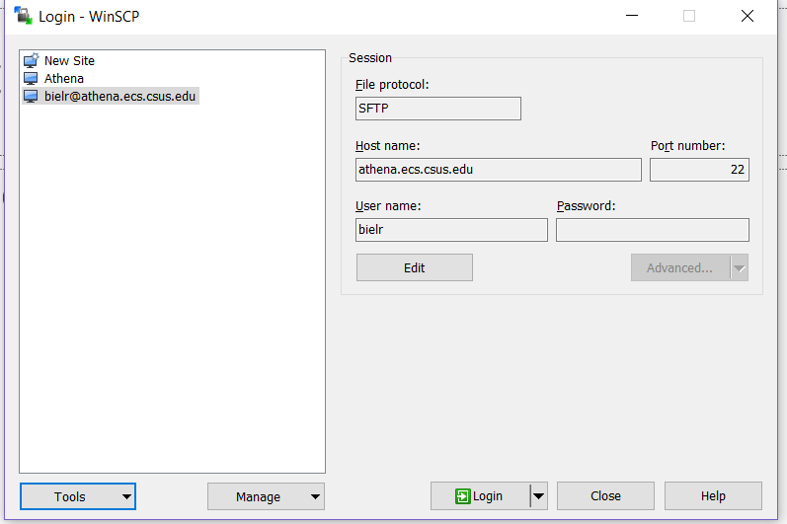
WinSCP Log-in Screen with settings

Slide 8
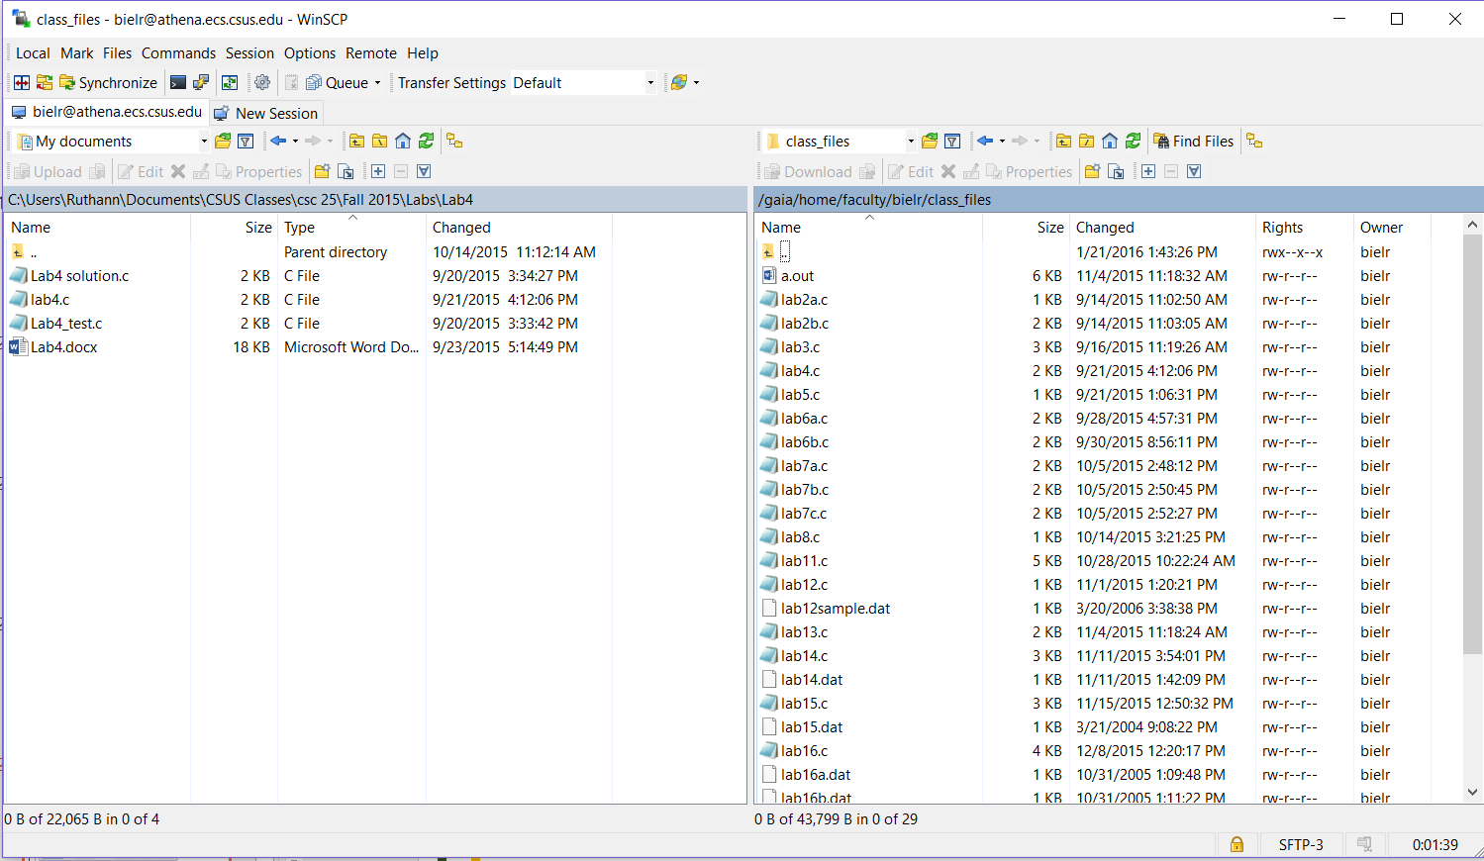
WinSCP Sample screen: left side is a folder on home computer, right side is folder on gaia

Slide 9
Optional software for home (MAC & Windows):
Free software that allows one to move files from one site to another, from athena to home, and the reverse.
Filezilla – https://filezilla-project.org/
Cyberduck - https://cyberduck.io/?l=en
Both software packages work on Windows or Mac.
A search on “cyberduck vs filezilla” will bring up a couple of comparison articles.

Slide 10
Logging onto a UNIX machine
Sit at a UNIX machine and log in.
As you enter your password, nothing will show on the screen.
Do a remote login using SSH
Most of us use PuTTY software to accomplish this.
The ECS computers all have PuTTY
To get PuTTY at home, download it from: http://www.chiark.greenend.org.uk/~sgtatham/putty/

Slide 11
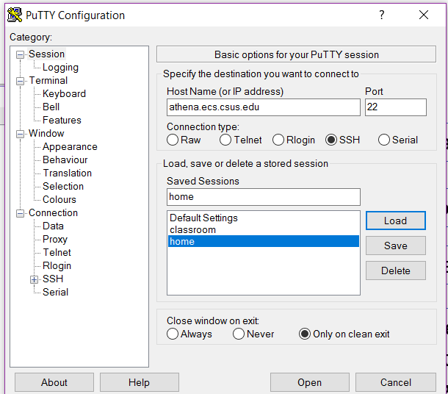
PuTTY Screen
Address of “athena”
Choose the option - SSH
I saved the session, named it “home”
Once the session is saved,
we can just double click on the session name,
and the log-in window will appear
Contains options to change font and font size

Slide 12
MAC Users
Open up a terminal/console window and type the following:
ssh yourECSname@athena.ecs.csus.edu
Press Enter.
When prompted, type “yes” to accept the server’s key.
Then enter your password.

Slide 13
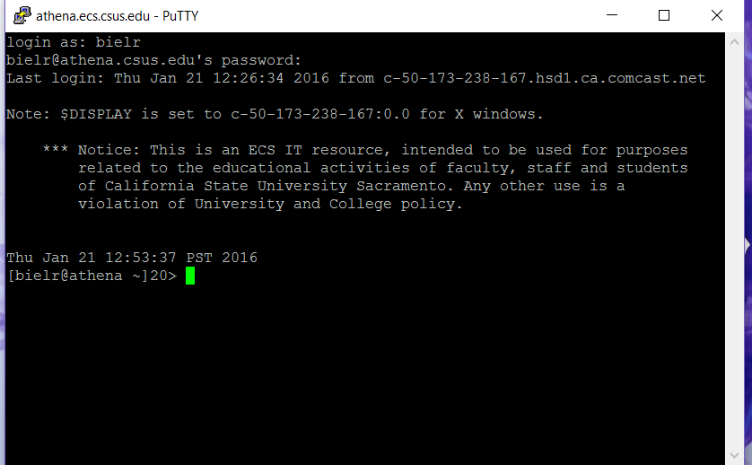
Login Screen

Slide 14
Shells:
A shell is an interface between you and the kernel of UNIX/Linux.
Kernel. The center, the core.
Shell. A way to communicate with the Kernel.
The default on our system is csh, read aloud as ‘C-shell’.

Slide 15
By doing “cat /etc/shells”, I found that athena has:
sh (Bourne Shell)
bash (superset, Born Again Shell. LOL)
nologin
tcsh
csh (spoken as C-shell) (Default on athena)
dash
ksh
It is possible to change the default shell,
using the command “chsh”.

Slide 16
Shell Verification
To see what Shell you are in, type:
> echo $SHELL

Slide 17
Getting help:
“Look at the “man” page.” You will hear this.
This means looking at the on-line manual which is extensive.
$ man command
Examples: /* will show you… */
$ man ls /* all the options for listing */
$ man gcc /* options for the compiler */
Maneuvering through a man page:
Hit space bar to advance thru page.
Hit Enter to advance the screen one line.
Hit “q” to quit.

Slide 18
Various Commands in UNIX/Linux

Slide 19
Command: ls
Purpose: List files in directory.
Format: ls [options] [file-list]
Some Options:
-a List all files, including hidden ones.
-d List directory names only, not ordinary files.
-g Show group information with listing.
-l Show long listing with extended information.
-r List in reverse order.
-s List in order of increasing size.
-t List in order of time, most recent first.
Example: ls ls -ra
ls –l ls -ls

Slide 20
Copying and Renaming Files:
Command: cp
Purpose: Copy a file.
Format: cp source-file target-file
Example: cp my.file file2
Result: There are now two identical files with different names.

Slide 21
Moving or renaming files:
Command: mv
Purpose: Move or rename a file.
Format: mv source-file target-file
Example: mv my.file file2
Result: One file with the target name exists.

Slide 22
Removing files:
Command: rm
Purpose: Remove a file.
Format: rm [option] file(s)
Option: -i Ask before deleting.
Often the default.
Example: rm file2
Result: The file is no longer listed or available.

Slide 23
The cat command:
Command: cat
Purpose: Display or create files.
Format: cat [source-file] [symbol] [target-file]
Examples: 1. cat this.month
2. cat lab1.c
Result: File displayed on screen, lines echoed on screen

Slide 24
The pwd command:
Command: pwd
Purpose: print name of current/working directory.
Format: pwd
Example & Result:
[bielr@athena csc60]> pwd
/gaia/home/faculty/bielr/csc60
[bielr@athena csc60]>

Slide 25
Starting Directory Structure on Linux
/ (root)
home many-other-directories
faculty student
bielr
csc60 csc 25 classfiles_csc60
mywork ClassExamples myworkF17
lab1 lab2 lab3

Slide 26
The cd command:
Command: cd
Purpose: Change directory.
Examples & Results:
1. cd Takes you to your home directory
cd .. Takes you up to the parent directory
cd lab1 Takes you down to a lower directory
cd mywork/lab1 Takes you down to a lower directory

Slide 27
The mkdir command:
Command: mkdir
Purpose: Make directories.
Examples & Results:
1. mkdir csc60 Makes a sub-directory named csc60
mkdir lab1 Makes a sub-directory named lab1
Directories can also be moved or renamed (mv), and copied (cp –r)

Slide 28
The rmdir command:
Command: rmdir
Purpose: remove empty directories.
Examples & Results:
1. rmdir csc60 Makes a sub-directory named csc60
rmdir lab1 Makes a sub-directory named lab1
Note:
To delete an empty directory, you must be in the directory above it or you need to type a full path name.

Slide 29
The clear command:
Command: clear
Purpose: clear the terminal screen
Example:
> clear

Slide 30
Other Assorted Commands
less, more – paging utilities
Use the “man” pages to find more
od – octal dump. For viewing raw data in octal, hex, control chars, etc.
Use the “man” pages to find more
ln – create hard (inode) or soft (symbolic) links to a file
[On creating a file, UNIX allocates the file an inode
number of 4 bytes, an index value for an array on the
disk. So every file has a unique inode number.]

Slide 31
Change The Prompt On athena (csh)
Change the prompt to show the folder/directory that you are in.
You need to type a SPACE after “set” and after the “m”.
Type in the command: set prompt=’[%n%m %~]!>’
The %n will show your name.
The %m will show your current folder.
The %~ will give you the command number.

Slide 32
REDIRECTION: (1 of 4)
$ ls /* lists all files in your directories */
$ ls | more /* pipes the output to the more program which
gives you a screen-full at a time */
The pipe symbol “|” redirects the standard output of one command to the standard input of another command or process.

Slide 33
REDIRECTION: (2 of 4)
Use > to redirect an output to a file.
So cal is the calendar command.
$ cal 2017 > my_calendar

Slide 34
REDIRECTION: (3 of 4)
Use >> to append to a file.
ps means process status.
$ ps >> my_file
Whatever was in my_file will now have the listing from the
ps command appended to it.

Slide 35
Just to make things clear on Redirection: (4 of 4)
Use of the pipe “|” sends output to a process.
Use of the redirection “>” sends output to a file.
NOTE: The details of Redirection vary from shell to shell.

Slide 36
OS/Shell Introduction
Getting Started
The End

